Slide 1
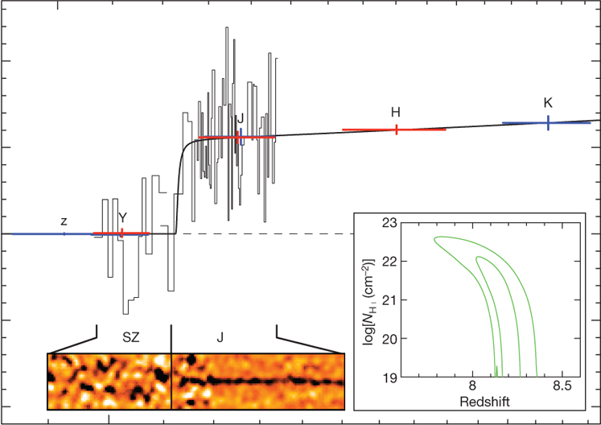
0.1
Rest-frame wavelength [μm]
0.2
20
10
Flux density at 16 h [μJy]
0
-10
-20
1
Observed wavelength [μm]
2

Slide 2
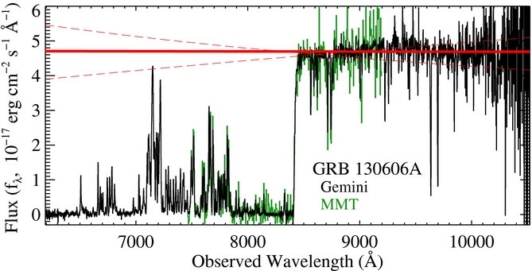
6
5
4
3
Flux [f_{λ}, 10⁻¹⁷ erg cm⁻² s⁻¹ Å⁻¹]
2
GRB 130606A
Gemini
MMT
1
0
0.7
Observed wavelength [μm]
1.0

Slide 3
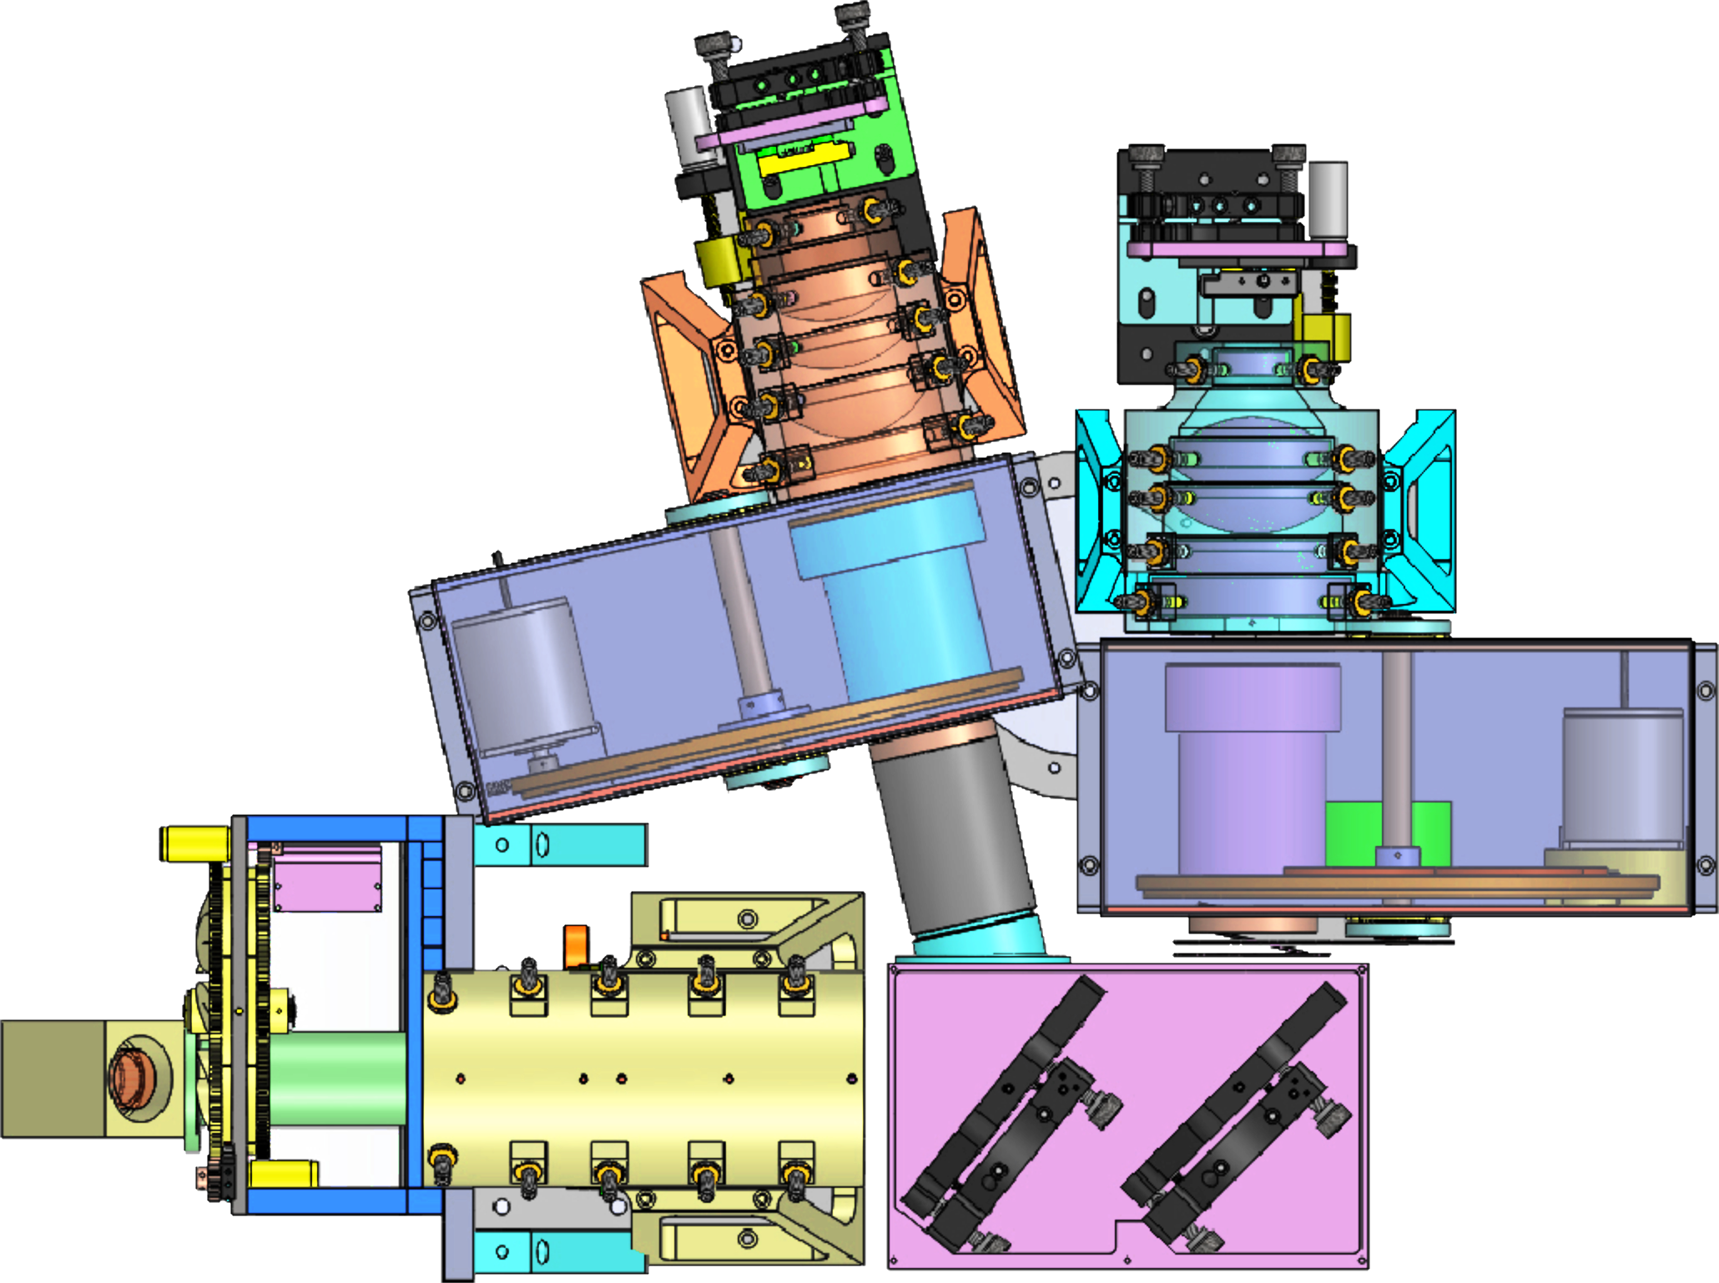


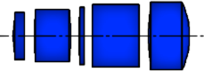
Y & J band
optical arm
H & K band optical arm
H2RG
detectors
10 cm
Beam from
DCT
Filter / grating wheels
DCT focus
Filter & slit wheels
Dichroic beamsplitter
Notes:
Here I show the layout of the primary science optics, designed by Dave Content at GSFC (describe design).
7 spherical lenses
8 lenses with non-zero conic constant
1 of these with radial polynomial terms
Materials: fused silica, CaF₂, BaF₂, ZnSe, S-TIH53
Plate scale: 0.35 arcsec / pixel, 18 μm pixel pitch
~50% of focused light from a point source is expected to be ensquared by a pixel

Slide 4
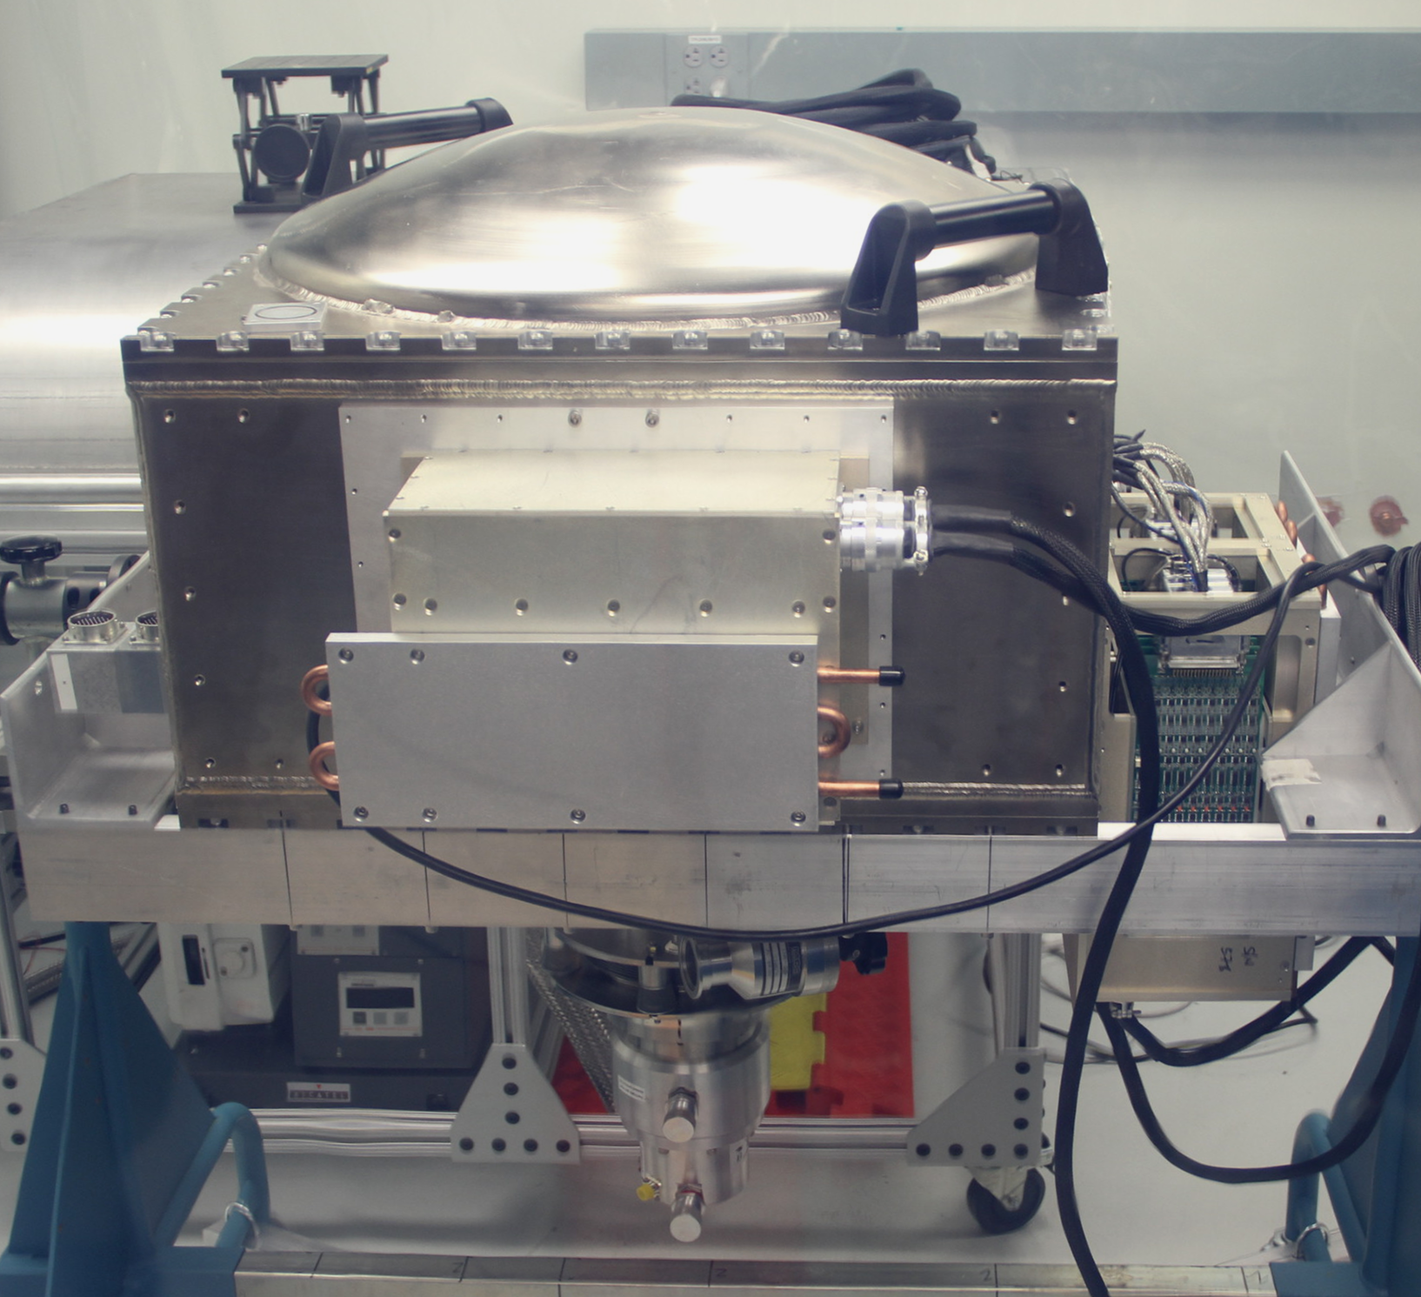
RIMAS dewar assembled in the lab
Detector electronics
and power supplies

Slide 5
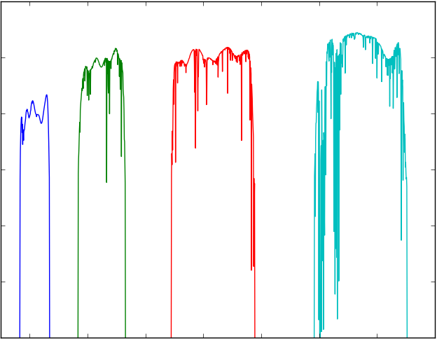
0.6
Estimated efficiency - photometry
0.0
1.0
Wavelength [μm]
2.2

